Slide 1
Building Tools With The Learning Tools Interoperability Specification
Michael d. hilborn and Artie Barrett
LTI Hands-On Workshop
July 11, 2014
https://github.com/Harvard-ATG/workshop-lti-basic
Copyright (c) 2014, President and Fellows of Harvard College
All rights reserved.

Slide 2


Agenda
What is LTI?
LTI tools in action
How LTI works
Writing an LTI tool
Challenges to writing LTI
Resources you can use
Questions?
Answers?
That, my young lass, we will get to soon!
Hmm… But what do these circles, arrows, and squares signify?

Slide 3
What Is LTI?
In which we learn what LTI IS and Proposes to Do

Slide 4





The Basics
*TLA: "Three Letter Acronym!"
LTI is a TLA: "Learning Tools Interoperability"
But first, let's consider another TLA, the LMS
(Learning Management System)
There is quite a landscape of LMS's
These LMS's offer a lot of tools, but not quite what I need. What if I want to write my own web app?

Slide 5

What if you wanted to write your own tool?
For example, a tool that takes advantage of some of your research data
You could write an independent tool and iFrame it
(But then no data can be passed from the LMS to the tool)
Most LMS's offer ways of "plugging in" external applications
This way your tool and the LMS can communicate!
So all I need to do is learn how my school's LMS extends itself, write my tool to its specs, and I'm done!
Not so fast, old sport. You are not thinking of the future!

Slide 6

Not so fast, indeed
What if you wanted to share your tool with some colleagues at another University?
But their University is running a different LMS?
And what if your University decided to switch to another LMS?
(It's happened before!)
I dare say, is there a solution?
You see, my dear friend, writing for one LMS means rewriting your tool for another. A duplication of effort and resources!

Slide 7
Yes, there is a solution… in the works…
Welcome, Learning Tools Interoperability!
Initiated by the IMS Global Learning Consortium http://www.imsglobal.org
LTI attempts to:
Create standards that all LMS's and tools can implement so that they can speak with each other
Make your coding language of choice independent of the LMS
Make certain that when an LTI tool is implemented, it can work with any LMS
Do the above in a systematic, phased approach
(v1.0 -> v1.1 ->v1.1.1 -> v2.0)
LTI

Slide 8

So, LTI moves us forward…
Tool
Canvas
Sakai
Moodle
Homegrown
Desire2Learn
From this…
To this…
Tool
Moodle
Tool
Canvas
Tool
Sakai
Tool
Desire2Learn
Tool
Homegrown
Patience! Get to that we will.
But the arrows are one-way! Shouldn't there be two-way communication?

Slide 9
LTI Tools In Action
In which we Demonstrate a few lti tools Integrated with CAnvas

Slide 10
How LTI Works
In which we go over the basic concepts of HOW LTI WORKS

Slide 11
Basic LTI (LTIv1.0)
To start an external LTI tool, the LMS must first launch the tool
A launch consists of two items sent to the tool:
An OAuth signature
A set of parameters (a few required, many recommended, others custom)
In other words, a signed HTTP POST request
Let's look at it in more detail…

Slide 12
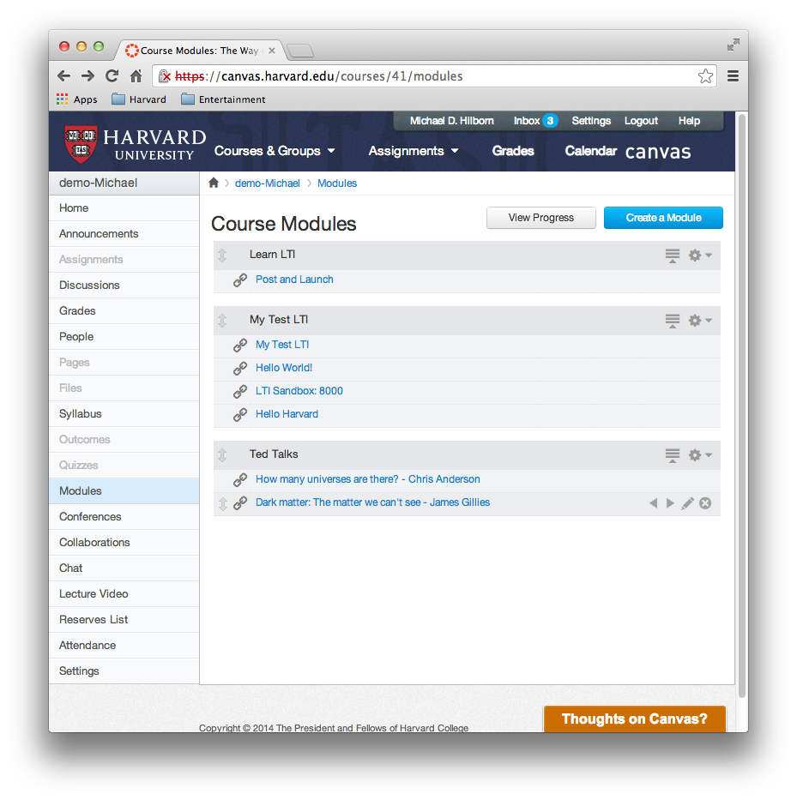

Basic LTI Launch – What The User Experiences
I feel like learning about Dark Matter today. I'll just click here…
Click

Slide 13

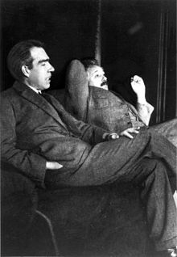
Basic LTI Launch – What The User Experiences
Oh, there's my content. That was relatively seamless…
Ah, but let's bore down into the mechanics of it.
Seems relatively simple enough!

Slide 14



Basic LTI Launch – What The Web Experiences
1
The web browser sends the request to the LMS server.
Click

Slide 15
Basic LTI Launch – What The Web Experiences
1
The web browser sends the request to the LMS server.
2
The LMS looks up information about user and course, and signs with secret/OAuth signature.

Slide 16
Basic LTI Launch – What The Web Experiences
1
The web browser sends the request to the LMS server.
2
The LMS looks up information about user and course, and signs with secret/OAuth signature.
3
LMS server sends data and secret/OAuth signature back to browser.

Slide 17
Basic LTI Launch – What The Web Experiences
1
The web browser sends the request to the LMS server.
2
The LMS looks up information about user and course, and signs with secret/OAuth signature.
3
LMS server sends data and secret/OAuth signature back to browser.
4
Browser sends launch, data, and secret/OAuth signature to tool server.

Slide 18
Basic LTI Launch – What The Web Experiences
1
The web browser sends the request to the LMS server.
2
The LMS looks up information about user and course, and signs with secret/OAuth signature.
3
LMS server sends data and secret/OAuth signature back to browser.
4
Browser sends launch, data, and secret/OAuth signature to tool server.
5
Tool verifies launch and secret/OAuth signature to process data.

Slide 19
Basic LTI Launch – What The Web Experiences
1
The web browser sends the request to the LMS server.
2
The LMS looks up information about user and course, and signs with secret/OAuth signature.
3
LMS server sends data and secret/OAuth signature back to browser.
4
Browser sends launch, data, and secret/OAuth signature to tool server.
5
6
Tool verifies launch and secret/OAuth signature to process data.
Tool server sends content back to the browser for viewing.

Slide 20

Basic LTI Launch – Launch Parameters
Houston, we are good to go with a basic-lti-launch-request.
When an LMS launches a tool, it must send the following parameters:
lti_message_type set to basic-lti-launch-request
lti_version set to LTI-1p0
resource_link_id referencing a unique id of a tool instance
Remember, these are just POST parameters
If a tool does not receive these parameters, it should gracefully fail

Slide 21

Basic LTI Launch – OAuth
We have to ensure that the launch parameters and other data are coming from the LMS
We do so by using OAuth signatures
But what, exactly, is OAuth?
Didn't I tell you not to accept that message without OAuth?
But OAuth seemed so complicated!

Slide 22

Basic LTI Launch – A Brief OAuth Primer
OAuth is a framework that defines a method for clients (i.e. web apps) to access server resources (web service) on behalf of a resource owner (i.e. end-user)
The end game of OAuth is an access token that the client may use to access protected resources on the server until/unless it is revoked
What does that mean?
Generic methodology for API authentication.
Resource owner’s credentials are protected (not shared with client)
Requests are protected by digital signatures.

Slide 23

Basic LTI Launch – A Brief OAuth Primer (cont'd)
LTI uses a subset of OAuth for protecting HTTP requests
A digital signature is a scheme designed to give the receiver of a request reason to believe that it is valid
Signatures help authenticate LMS/Tool requests and prevent unauthorized requests:
Ex: protects the requests from tampering with the POST params
Ex: protects the LMS/Tool from replay attacks (repeated POSTs)
For this reason, LTI requests should be signed and verified
Looks like that fella is tamperin' with our POST parameters…
Not with our OAuth signature, he won't.

Slide 24

Basic LTI Launch – A Brief OAuth Primer (cont'd)
ua = user/context attributes
secret = shared secret
sig = oauth_sig(ua, secret)
What is your OAuth secret?
LMS
Tool
POST ua, sig
confirm that
sig === oauth_sig(ua, secret)

Slide 25
Basic LTI Launch – OAuth Parameters
So, when an LMS launches a tool, it must send the following parameters:
oauth_callback often set to about:blank
oauth_consumer_key set to the consumer key
oauth_nonce set to the nonce generated by the LMS
oauth_signature set to the signature sent by the LMS
oauth_signature_method referencing the encryption (must use at least HMAC-SHA1)
oauth_timestamp representing the time/date of the request
oauth_version set to version of OAuth (such as 1.0)
Coupled with the secret that is shared by the LMS and tool, the tool must verify that the signature is valid before proceeding.

Slide 26
Basic LTI Launch – Recommended Parameters
Although not required, it is recommended that these parameters be sent to an LTI tool:
user_id referencing unique id of current user
roles set to the users role, such as Learner or Instructor
lis_person_name_full set to the user's full name
lis_person_name_given set to the user's first name
lis_person_name_family set to the user's last name
resource_link_title referencing the name of the tool instance

Slide 27
Basic LTI Launch – Recommended Parameters (cont'd)
There's more…
context_id referencing unique id of the course
context_title set to the name of the course
context_label set to the description of the course
tool_consumer_info_product_family_code set to the name of the LMS
tool_consumer_info_version set to the version number of the LMS
tool_consumer_instance_guid set to the instance of the LMS
tool_consumer_instance_name set to the name of the instance of the LMS
tool_consumer_contact_version set to the email of the LMS
And if that weren't enough…

Slide 28
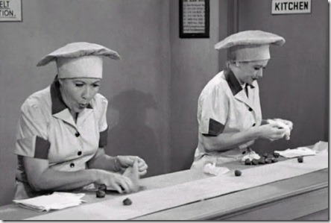
Basic LTI Launch – Custom Parameters
Any number of custom values can be optionally sent to the tool
The parameters should start with custom_
Such as:
custom_canvas_user_id
custom_canvas_user_login_id
Hold onto your hat, there's even more! But you can find the references online.
So many parameters! I can't keep up!

Slide 29

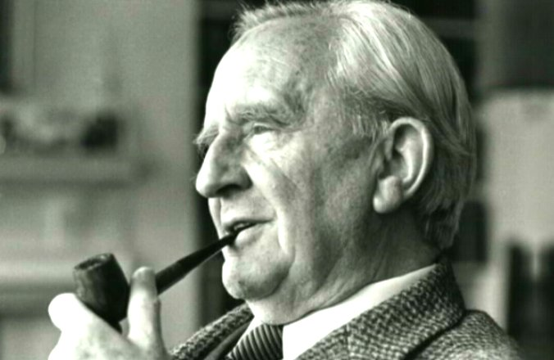
Basic LTI Launch – A Review
To start an external LTI tool, the LMS must first launch the tool
A launch consists of two items sent to the tool:
An OAuth signature
A set of parameters (a few required, many recommended, others custom)
In other words, a signed HTTP POST request
And now that we know what an LTI tool should expect…
…You can see us going about writing a tool!

Slide 30
Writing An LTI Tool
In which we demonstrate how to write a simple "Hello world" tool

Slide 31
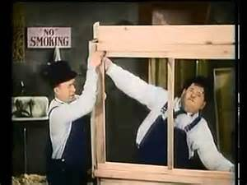
First, Some Tools Of The Trade
Choose a language
(We're choosing PHP for our demo)
Install a Basic LTI library
(Here are a few: http://www.edu-apps.org/code.html)
Set up a development environment
(We're using Vagrant and VirtualBox)
Find an LMS that supports LTI
(We're using Canvas)
Oh, dear. I seem to have forgotten the LTI library!
Well, this is another fine mess you have gotten me into.

Slide 32
Examining The Code
<?php
require_once 'ims-blti/blti.php';
// Any other setup code you might want
$context = new BLTI("secret", false, false);
header('Content-Type: text/html; charset=utf-8');
?>
<!DOCTYPE html>
<html>
<!-- HTML goes here -->
<?php
if ($context->valid) {
?>
<h2>Hello LTI!</h2>
<?php
} else {
?>
<h2>This was not a valid LTI launch</h2>
<?php
}
?>
<!-- More HTML goes here -->
</html>
First, we include the Basic LTI library in our code

Slide 33
Examining The Code
<?php
require_once 'ims-blti/blti.php';
// Any other setup code you might want
$context = new BLTI("secret", false, false);
header('Content-Type: text/html; charset=utf-8');
?>
<!DOCTYPE html>
<html>
<!-- HTML goes here -->
<?php
if ($context->valid) {
?>
<h2>Hello LTI!</h2>
<?php
} else {
?>
<h2>This was not a valid LTI launch</h2>
<?php
}
?>
<!-- More HTML goes here -->
</html>
First, we include the Basic LTI library in our code
Then we initialize the Basic LTI object…

Slide 34
Examining The Code
<?php
require_once 'ims-blti/blti.php';
// Any other setup code you might want
$context = new BLTI("secret", false, false);
header('Content-Type: text/html; charset=utf-8');
?>
<!DOCTYPE html>
<html>
<!-- HTML goes here -->
<?php
if ($context->valid) {
?>
<h2>Hello LTI!</h2>
<?php
} else {
?>
<h2>This was not a valid LTI launch</h2>
<?php
}
?>
<!-- More HTML goes here -->
</html>
First, we include the Basic LTI library in our code
Then we initialize the Basic LTI object…
…with our shared OAuth secret

Slide 35
Examining The Code
<?php
require_once 'ims-blti/blti.php';
// Any other setup code you might want
$context = new BLTI("secret", false, false);
header('Content-Type: text/html; charset=utf-8');
?>
<!DOCTYPE html>
<html>
<!-- HTML goes here -->
<?php
if ($context->valid) {
?>
<h2>Hello LTI!</h2>
<?php
} else {
?>
<h2>This was not a valid LTI launch</h2>
<?php
}
?>
<!-- More HTML goes here -->
</html>
First, we include the Basic LTI library in our code
Then we initialize the Basic LTI object…
…with our shared OAuth secret
That's it, really… If the LMS sends this tool the proper LTI and OAuth parameters…

Slide 36
Examining The Code
<?php
require_once 'ims-blti/blti.php';
// Any other setup code you might want
$context = new BLTI("secret", false, false);
header('Content-Type: text/html; charset=utf-8');
?>
<!DOCTYPE html>
<html>
<!-- HTML goes here -->
<?php
if ($context->valid) {
?>
<h2>Hello LTI!</h2>
<?php
} else {
?>
<h2>This was not a valid LTI launch</h2>
<?php
}
?>
<!-- More HTML goes here -->
</html>
First, we include the Basic LTI library in our code
Then we initialize the Basic LTI object…
…with our shared OAuth secret
That's it, really… If the LMS sends this tool the proper LTI and OAuth parameters…
…you can check to see if the launch was valid; if so, write your code!

Slide 37
Examining The Code
<?php
require_once 'ims-blti/blti.php';
// Any other setup code you might want
$context = new BLTI("secret", false, false);
header('Content-Type: text/html; charset=utf-8');
?>
<!DOCTYPE html>
<html>
<!-- HTML goes here -->
<?php
if ($context->valid) {
?>
<h2>Hello LTI!</h2>
<?php
} else {
?>
<h2>This was not a valid LTI launch</h2>
<?php
}
?>
<!-- More HTML goes here -->
</html>
First, we include the Basic LTI library in our code
Then we initialize the Basic LTI object…
…with our shared OAuth secret
That's it, really… If the LMS sends this tool the proper LTI and OAuth parameters…
…you can check to see if the launch was valid; if so, write your code!
Otherwise, fail gracefully

Slide 38

Is It Really That Simple?
No, of course not
Which brings us to our next topic…
Not in this case. The truth is out there…
Sometimes the simplest solution is the best answer…

Slide 39
Challenges
In which we discuss the challenges of implementing lti tools

Slide 40

Challenges – The Learning Curve
It takes time to learn things
Basic LTI specifications
OAuth specifications
Your favorite LMS specifications
Your favorite Basic LTI library
I know LTI…
Show me.

Slide 41
Challenges – Setting Up (and Privacy)
It takes time to set things up
Your development environment
Your production environment
(You really want to put this behind SSL)
And speaking of security…
…Your tool still needs to comply with privacy
FERPA, HIPAA, etc.

Slide 42
Challenges – Two-Way Communication
What do you mean we're not coming back?!
So far, we've been talking about Basic LTI (v1.0)
Basic LTI describes a launch...
But it's mostly a one-way trip: The tool generally behaves independently in an iFrame
(There is a way to send messages back to the LMS after the tool has finished its job)

Slide 43
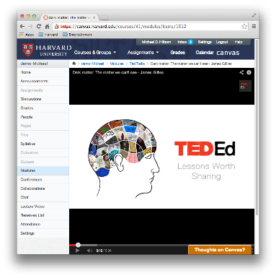
Challenges – Two-Way Communication
So we have this…
Wouldn't it be great to have this…?
1
1
2
2
The LMS and the tool talk with each other!
3
3
4
4
5

Slide 44
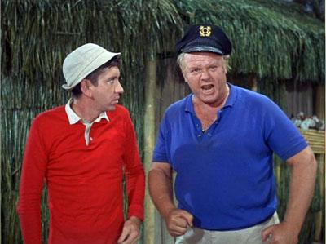
Challenges – Two-Way Communication
LTI v1.1 does support sending outcomes (grades) back to the LMS
But that's about all
You can, of course, have the tool use the LMS extensions and APIs…
…But that brings us back to rewriting code for each LMS!
Darn it! This seems to happen every episode!
Geez, we're right back to where we started!

Slide 45
Abstract Your Code
Fortunately, there are ways to minimize re-writing
Abstract any portion of code that interacts with an LMS
That way you need only have to rewrite one portion of your code if you switch to another LMS
Code for Canvas
Canvas
Only rewrite this
LTI Tool Core
Code for Home-grown
Home-grown

Slide 46
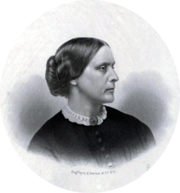
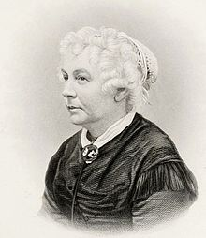
LTIv2.0
Utilizes REST-level 3 web services model for two-messaging between the LMS and your tool
But it was just released in January 2014
Doesn't seem to be extensively supported yet
(So we won't discuss it, but it's out there)
Perhaps LTI v2.0 will be the answer to our LMS woes.
At the very least, it will be progress…

Slide 47
Resources
In which we list a variety of urls that can help you out

Slide 48
Introductions To LTI
The Official IMS LTI Page http://www.imsglobal.org/lti/
LTI Tutorial http://developers.imsglobal.org/tutorials.html
Briefing Paper on LTI http://publications.cetis.ac.uk/wp-content/uploads/2012/05/LTI-Briefing-Paper.pdf
Edu Apps – An open collection of learning tools built on LTI http://www.edu-apps.org/index.html

Slide 49
Developing For LTI
IMS Developers Web Site http://developers.imsglobal.org/
Writing LTI Stuff (with links to libraries) http://www.edu-apps.org/code.html
Canvas Dev and Friends – A Course for Canvas Development https://canvas.instructure.com/courses/785215

Slide 50
OAuth Resources
OAuth Web Site http://oauth.net/
The OAuth 1.0 Guide http://hueniverse.com/oauth/guide/
OAuth for Beginniners http://blog.bittercoder.com/2008/06/10/oauth-for-beginners/
Introduction to OAuth http://blog.varonis.com/introduction-to-oauth/

Slide 51
Vagrant and VirtualBox
Oracle VirtualBox https://www.virtualbox.org/
Vagrant http://www.vagrantup.com/
A beginner's guide to Vagrant http://www.erikaheidi.com/2013/07/02/a-begginers-guide-to-vagrant-getting-your-portable-development-environment/
Automating Development Environments with Vagrant and Puppet http://blog.kloudless.com/2013/07/01/automating-development-environments-with-vagrant-and-puppet/

Slide 52
Kudos
In which thank the many people who made this presentation possible

Slide 53
Kudos
Our colleagues in the Academic Technology Group
Our colleagues in TLT
IMS Global Learning Consortium
And all of you!

Slide 54
Questions?
In which we end our presentation and attempt to answer your questions

Slide 55
Answers!
In which we reveal the identity of the characters in our presentation

Slide 56
Nick Carraway & Jay Gatsby
Daedalus & Icarus
Sherlock Holmes & Dr. Watson
Thelma & Louise
Luke Skywalker & Yoda
Lucy & Ethel
C.S. Lewis &
J. R. R. Tolkien
Albert Einstein & Niels Bohr

Slide 57
Susan B. Anthony
&
Elizabeth Cady Stanton
Laurel & Hardy
Dana Scully & Fox Mulder
Neo & Morpheus
Gilligan & The Skipper

Slide 58
The End
In which we all Start working with lti!
http://blogs.law.harvard.edu/acts/

